Slide 1
Seminole County, Florida
2018 Annual Audit Presentation
Presented By: Daniel J. O’Keefe, CPA

Slide 2
Reports Issues
County-wide CAFR (BOCC):
Independent Auditors’ Report – Page 1
Report on Internal Control over Financial Reporting and Compliance – Page 197
Independent Accountant’s Report – Investment Compliance – Page 199
Independent Auditor’s Management Letter – Page 200
Federal and State Single Audit Reports – Page 202
2

Slide 3
Reports Issued – Cont.
Clerk, Property Appraiser, Sheriff, Supervisor of Elections and Tax Collector:
Independent Auditor’s Report – Financial Statements
Report on Internal Control over Financial Reporting and Compliance
Independent Accountant’s Report – Investment Compliance
Independent Auditors’ Management Letter
3

Slide 4
Reporting Units
Entity-wide Financial Statements:
Governmental activities
Business-type activities
Governmental Funds:
    General
    County Transportation Trust
    Transportation Impact Fee
    Infrastructure Surtax
    Fire Protection
    17/92 Redevelopment
    Nonmajor Governmental Funds
4

Slide 5
Reporting Units – Cont.
Entity-wide Financial Statements – Cont:
Proprietary Funds:
    Water and Sewer
    Solid Waste
  Agency Funds
  Notes to Financial Statements
Financial Statements of the Officers:
General and Special Revenue funds
Agency Funds
Notes to the Financial Statements
5

Slide 6
Differences Between Government and Commercial
 | Government | Commercial
Standard-setting bodies | Governmental Accounting Standards Board (GASB) | Financial Accounting Standards Board (FASB)
Financial reporting | Use of funds, budgetary, top level reporting, MD&A, RSI, CAFR | Single-statement presentation
Basis of accounting | Full accrual - proprietary Modified accrual – governmental funds | Full accrual
Reporting units | Multiple | Single
Audit standards | AICPA ASB, GAO, OMB A-133, Auditor General | AICPA ASB
Budgets | Required | Optional
6

Slide 7
Key Terms
Expenditure (applied against current financial resources) vs. Expense (when incurred)
  Capital, principal payments on debt, etc.
Revenue (when available) vs. Income (when earned)
Governmental funds (modified accrual)
Proprietary funds (full accrual)
Agency funds (full accrual)
7

Slide 8
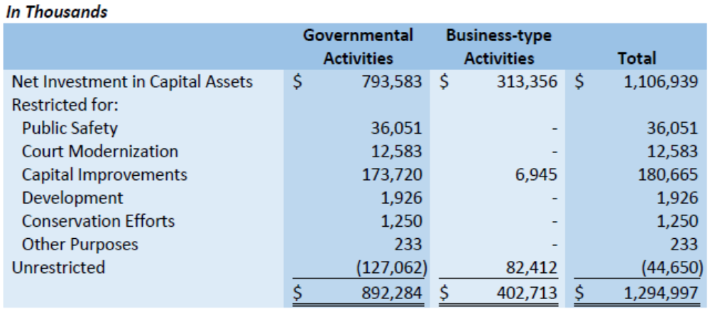
Net Position
8

Slide 9
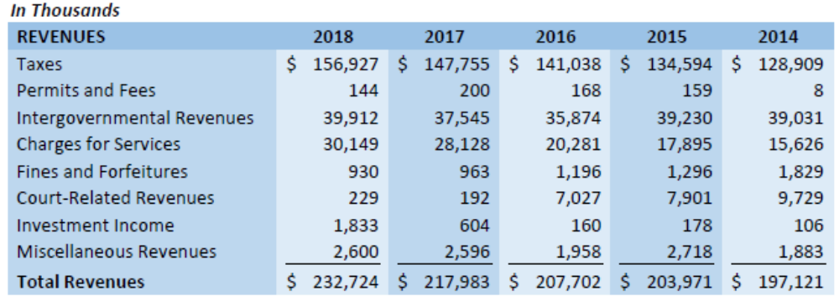
5 Year Revenue Comparison
9

Slide 10
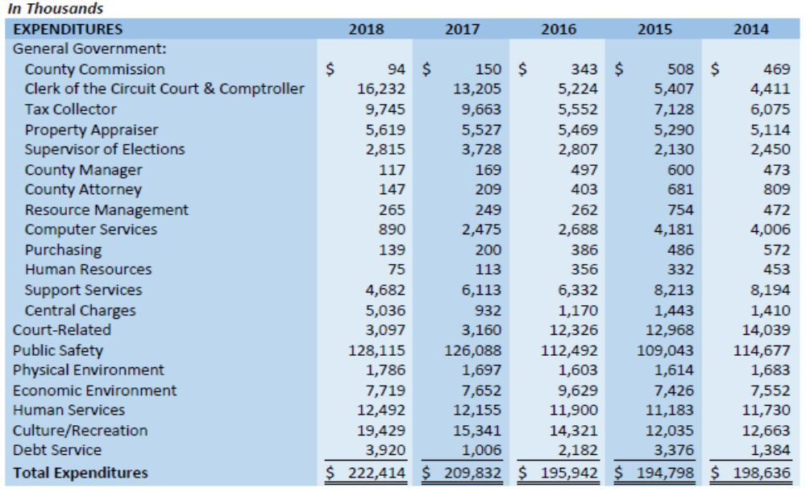
5 Year Expenditure Comparison
10

Slide 11
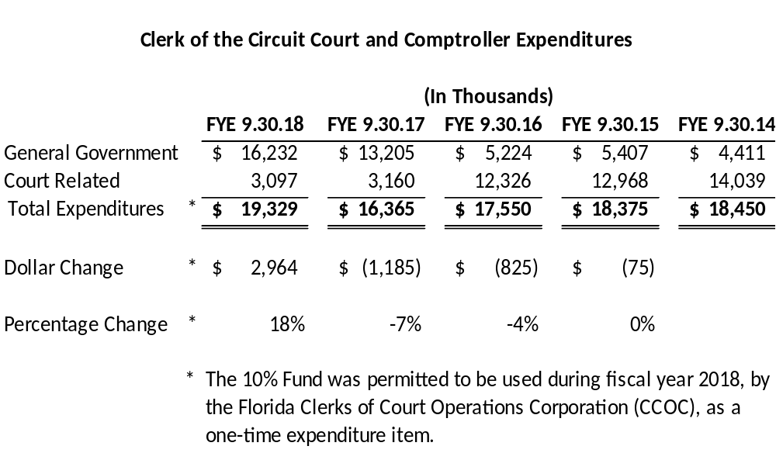
Clerk of the Circuit Court and Comptroller
5 Year Expenditure Comparison
11

Slide 12
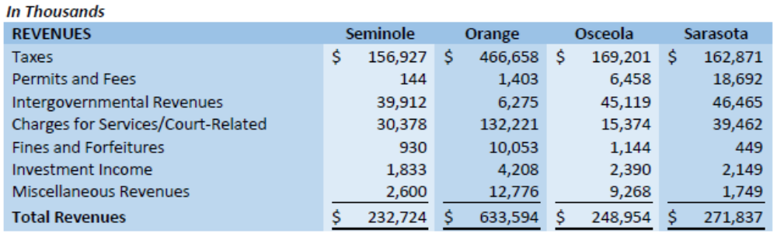
Revenue Benchmark
12

Slide 13
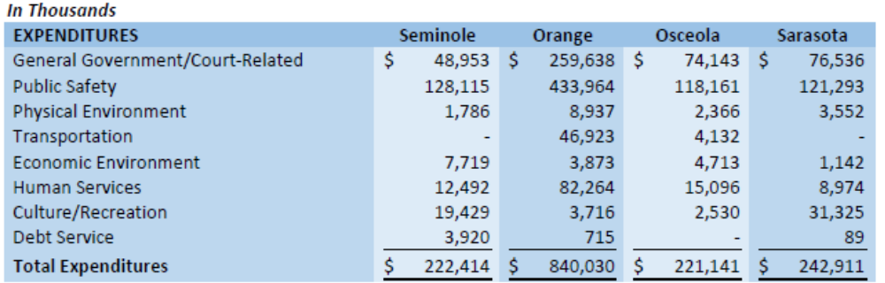
Expenditure Benchmark
13

Slide 14
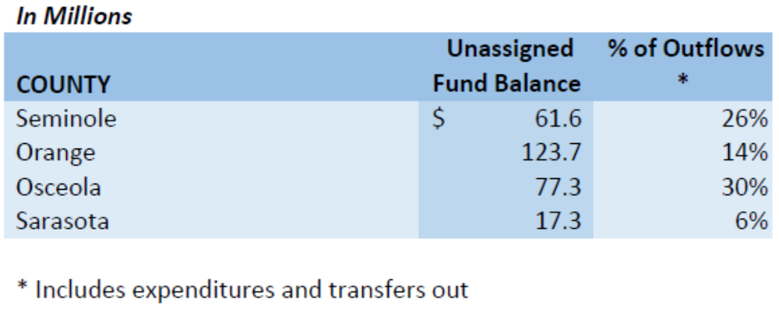
GF Fund Balance Benchmark
14

Slide 15
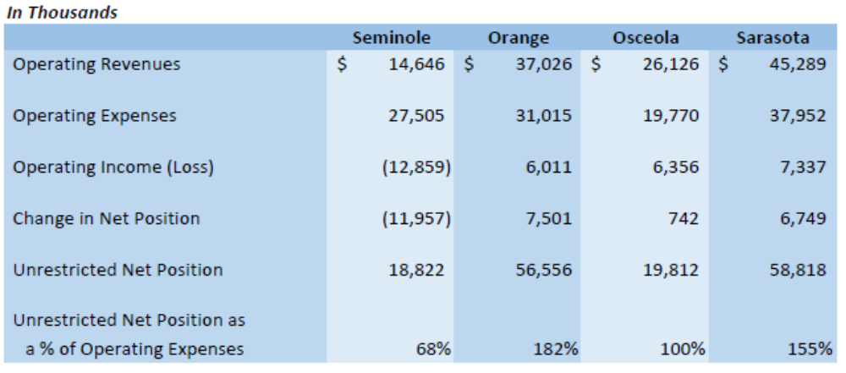
Solid Waste Benchmark
15

Slide 16
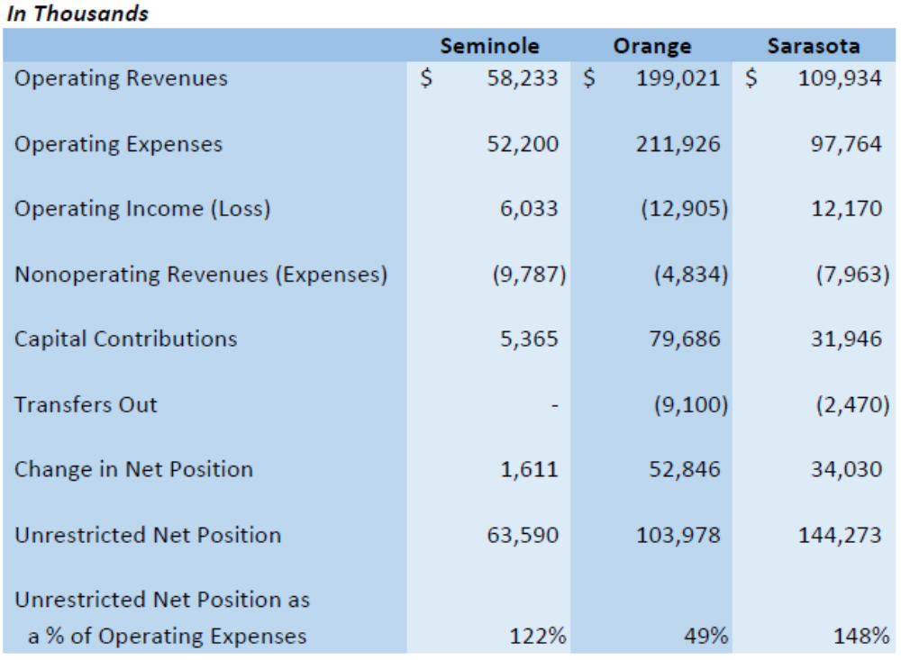
Water and Sewer Benchmark
16

Slide 17
17

